Slide 1
IT 106: Introduction to IT Problem Solving Using Computer Programming
Module 2b
Variables and Data Types

Slide 2
In This Lecture
Variables
Comments
Input/Output
Arithmetic Operations
Converting and Formatting Data
Strings

Slide 3
Questions?

Slide 4
Variables

Slide 5
Declaring Variables
Most computer programs hold temporary values in named storage locations (variables)
They are named for easy access
There are many different types and sizes of storage available
Each is used depending on what you are trying to store
Variables are declared by telling the compiler
What type (and size, if applicable) of variable you need
What name you will use to refer to it

Slide 6

Variable Example: Soda Deal
Problem
Soft drinks are sold in cans and bottles. A store offers a six-pack of 12-ounce cans for the same price as a two-liter bottle. Which should you buy? (Note: 12 fluid oz. equals approximately 0.355 liters)

Slide 7
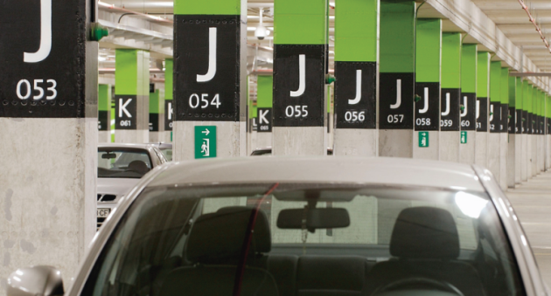
Variable Contents
Each variable has an identifier (name) and contents
You can (optionally) set the contents of a variable when you declare it
Example: int cansPerPack = 6;
Imagine a parking space in a parking garage
Identifier (Name): J053
Contents: Bob's BMW
cansPerPack
6
A variable is a storage location with a name

Slide 8
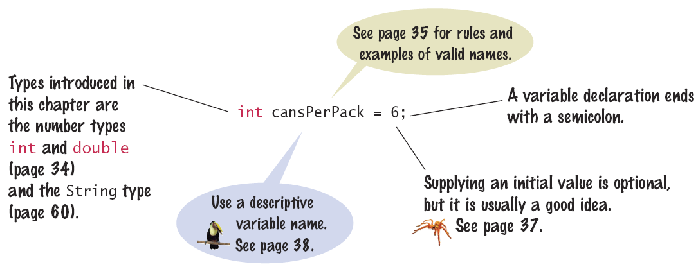
Syntax: Variable Declaration
When declaring a variable, you often specify an initial value
This is where you tell the compiler the type (and size if appropriate) of data it will hold

Slide 9
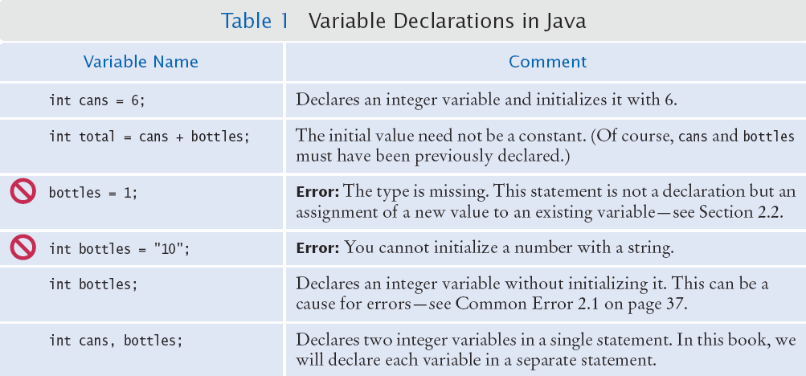
Example Variable Declarations

Slide 10
Naming Variables
The name should clearly describe the purpose
In this case it is better to be verbose than not
Example: canVolume is better than cv
Simple Rules to Choosing a Name:
Use only letters, numbers, or the underscore (_)
Don't start with a number
Separate words with "camelCase" notation
Example: canVolume, cansPerPack
Variable names are case-sensitive
Don't use Java reserved words
Example: can't have a variable named int
Variables start with lower case / Class names start with upper case
Not a requirement, but a general best practice

Slide 11
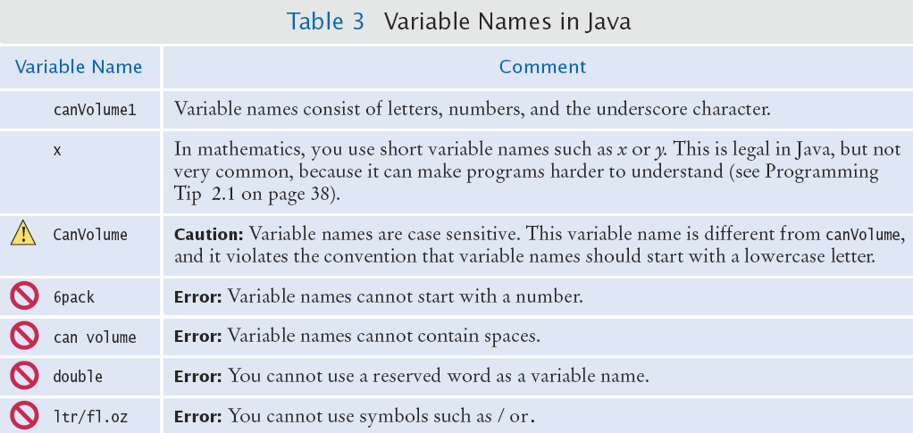
Naming Variables (Cont'd)
Legal and illegal variable names

Slide 12
Variable Data Types
Data types are used to tell the compiler what type of data you are trying to store
Helps to allocate the correct amount of memory
Common Types
A whole number (no fraction) – int
A number with a fraction part – double
A single character – char
A word (a group of characters) – String
The type is specified when declaring the variable
Example: int cansPerPack = 6;
Example: double canVolume = 12.0;
Example: String name = "Jack";
Back to the garage analogy, parking spaces may be different sizes for different types of vehicles
E.g. bicycle, motorcycle, full size, van, etc.

Slide 13
Variable Data Types (Cont'd)
Integer Types (Whole numbers, no fractions)
byte: a very small number (-127 to +128)
short: a small number (-32,768 to +32,767)
int: a large number (-2,147,483,648 to +2,147,483,647)
long: a huge number
Floating Point Types
float: a huge number with decimal places
double: a more precise, floating type, used for calculations
Other Types
boolean: true or false
char: one symbol in single quotes, such as: 'a'

Slide 14
Variable Data Type Storage
Integer Types (Whole numbers, no fractions)
byte:
short:
int:
long:
Floating Point Types
float:
double:
Other Types
boolean:
char:

Slide 15
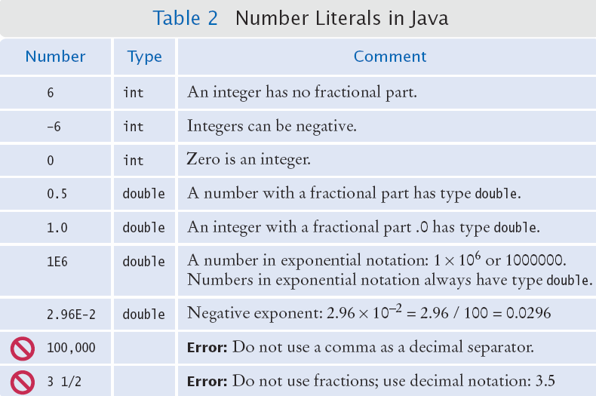
Number Literal Examples in Java
Use the double
type for floating-
point numbers.

Slide 16
Java Comments
There are three forms of comments
// a single line comment (or rest of line to the right)
/* multi-line comment – all comments within /* */ */
/** multi-line Javadoc comments – used to automatically generate documentation */
The compiler ignores commented code
Use comments at the beginning of each program and within the program to clarify details of the code

Slide 17
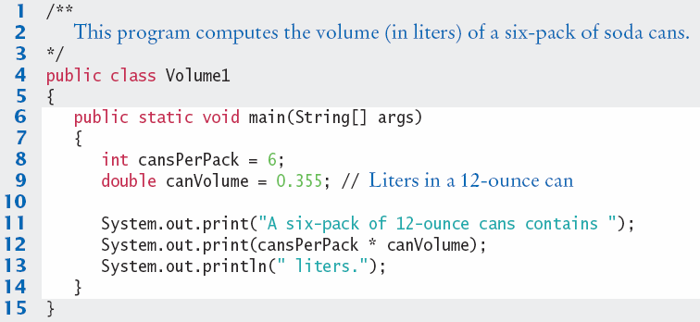
Java Comment Example
External
Documentation
Internal Documentation
Lines 1-3 are Javadoc comments for the class "Volume 1"
Line 9 uses a single-line comment to clarify the unit of measurement

Slide 18
Common Variable Errors
Undeclared Variables
You must declare a variable before you use it: (i.e. above in the code)
double canVolume = 12 * literPerOunce; // ??
double literPerOunce = 0.0296;
Uninitialized Variables
You must initialize (i.e. set) a variable’s contents before you use it
int bottles;
int bottleVolume = bottles * 2; // ??

Slide 19
Common Variable Errors (Cont'd)
Overflow
The storage for the variable cannot correctly hold the value
Example: Remember the int data type can store values in the range of -2,147,483,648 to +2,147,483,647
int oneThousand = 1000; // OK
int oneMillion = 1000 * oneThousand; // OK
int oneBillion = 1000 * oneMillion; // OK
System.out.println(3 * oneBillion); // ??
Output will print: -1294976296
Why?
The result (3 billion) overflowed the capacity of an int, truncated the value, and provided something useless
To fix this, use a long (if integer) or a double (if floating point)

Slide 20
Variable Assignment
You can use the assignment operator (=) to place a new value into a variable
int cansPerPack = 6; //declare and initialize
cansPerPack = 8; //assignment
Warning! The = sign is NOT used for comparison
It copies the value on the right into the variable on the left side
Comparisons will be covered a bit later

Slide 21
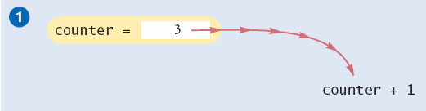
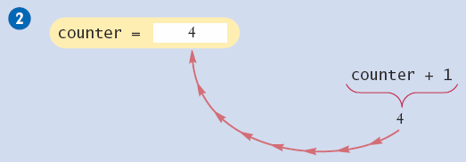
Incrementing a Variable
Code: counter = counter + 1;
Steps:
Do the right hand of the assignment first
Find the value stored in counter, then add 1 to it
Store the result in the variable named on the left side of the assignment operator (counter in this case)

Slide 22
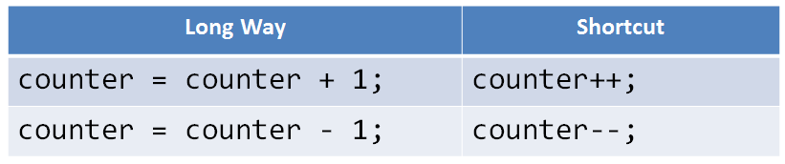
Shorthand for Incrementing
Incrementing (+1) and decrementing (-1) integer types is so common that there is a shorthand version for each

Slide 23
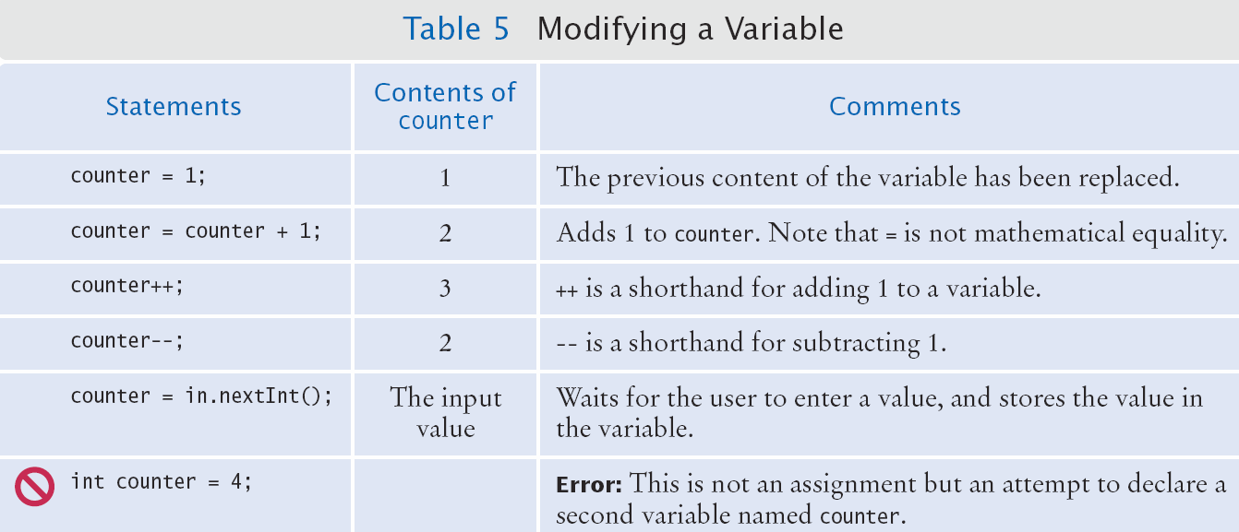
Modifying a Variable
Assumes counter has already been declared using int counter;

Slide 24
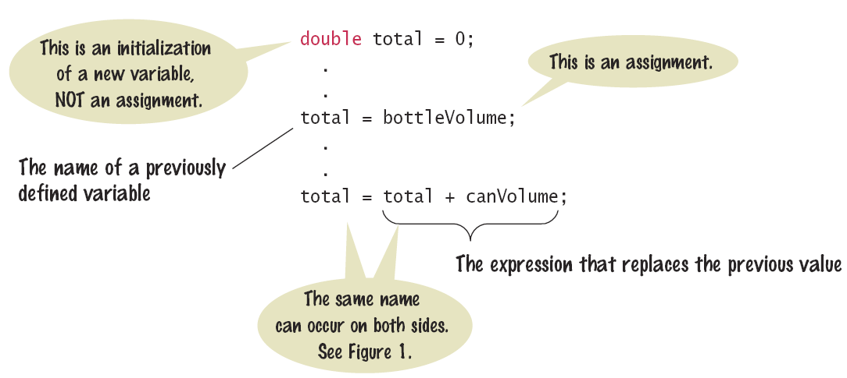
Syntax: Assignment
Review of the assignment statement
The value on the right is copied to the variable on the left

Slide 25
Constants
It is a good practice to declare values that will not change during program execution as constants
Use the reserved word final before the type in the declaration
Example: final double BOTTLE_VOLUME = 1.75;
They can then be used like any other variable
double volume = bottles * BOTTLE_VOLUME;
Constants are usually declared near the beginning of the program or class
You cannot assign a new value to a constant at run-time.

Slide 26
Questions?

Slide 27
Input/Output

Slide 28
Using a Graphical User Interface
Previously for output, we have been using System.out.println to print to the IDE or a console window
Users are now used to seeing graphical interfaces instead of just a text-based command prompt
For now, don't worry about the details
Pay attention to the format of the code

Slide 29
Using a GUI for Output
JOptionPane: Package that provides dialog boxes for GUI output
Benefit: Makes your program look "prettier"
Implementation
Import Java package containing JOptionPane class
Use: import javax.swing.JOptionPane; at the top of your .java file
Use showMessageDialog() function, which is similar to println(), but takes in two pieces of data instead
Pass null and the String you want to output

Slide 30

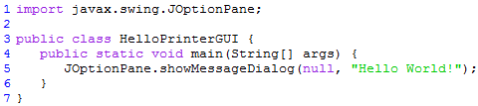
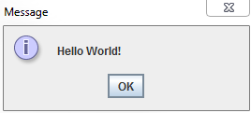
Using a GUI for Output
Old
New

Slide 31
Reading Input
You frequently will need to ask the user for input (i.e. prompt them) and then save what was entered
We will be reading input from the keyword

Slide 32

Reading Input (Cont'd)
Three step process to do this, using a GUI
Import Java package containing JOptionPane class
Use: import javax.swing.JOptionPane; at the top of your .java file
Use methods of the JOptionPane class to show an input dialog
Use: JOptionPane.showInputDialog("MessageToUser");
In the same line, convert the input entered into the correct data type if the data type is numeric and calculations will be needed

Slide 33
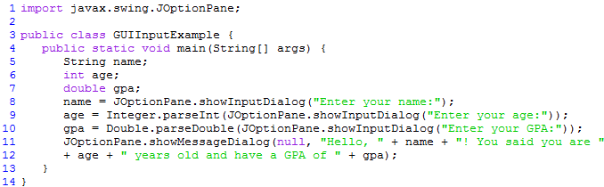
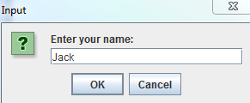
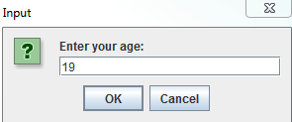
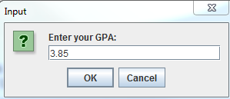
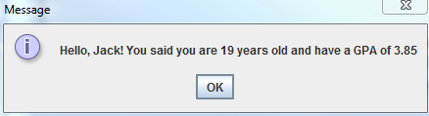
Example: Reading Input

Slide 34
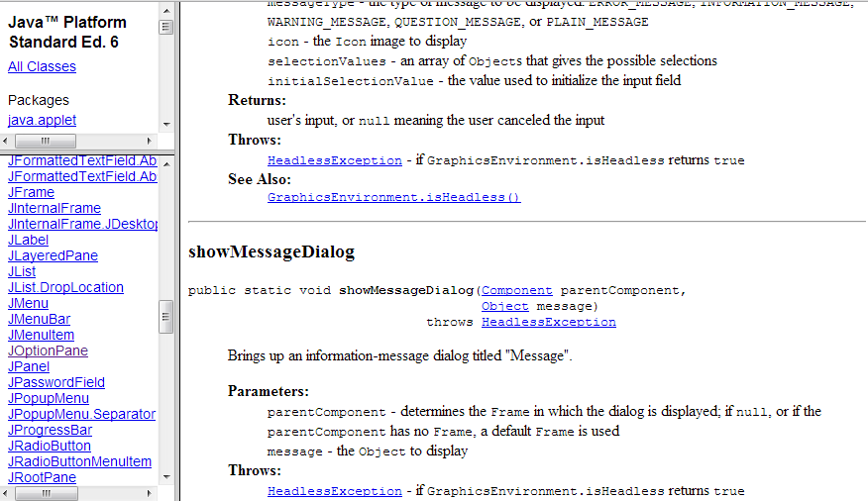
Tip: Java API Documentation
Lists all of the classes and methods within the Java API
On the Web: http://docs.oracle.com/javase/6/docs/api/
Packages
Classes
Methods

Slide 35
Questions?

Slide 36
Arithmetic Operations

Slide 37


Arithmetic Operations
Java supports all of the same basic calculator operations
Addition, subtraction, multiplication, division
However, Java expressions may only be written on one line
Precedence is similar to Algebra
Remember PEMDAS
Parentheses, exponents, multiplication/division, addition/subtraction
No
Yes

Slide 38
Integer Division and Remainders
If both operands are integer types, you need to be careful not to lose precision
int first = 7, second = 4, answer;
answer = first / second; // answer is 1!
The result is an integer. The fraction was lost.
To find the fractional part, use the modulus operator (%)
int first = 7, second = 4, answer, remainder;
answer = first / second;
remainder = first % second; // set to 3
You could also use floating-point data types, instead

Slide 39
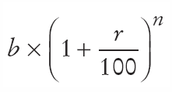

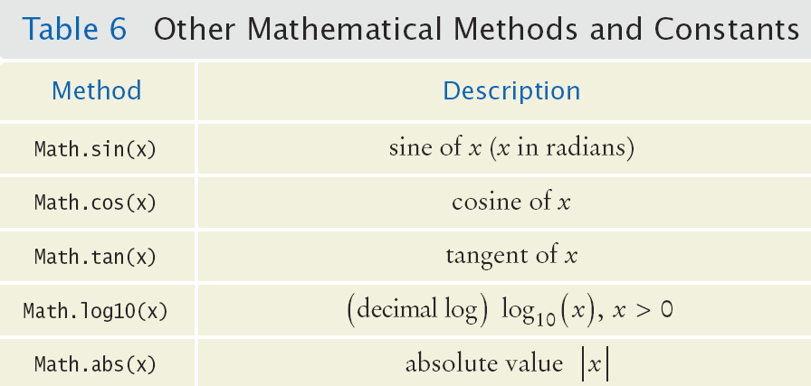
Powers and Roots
There are no symbols for powers and roots
But, methods exist in the Java Math class
Java

Slide 40
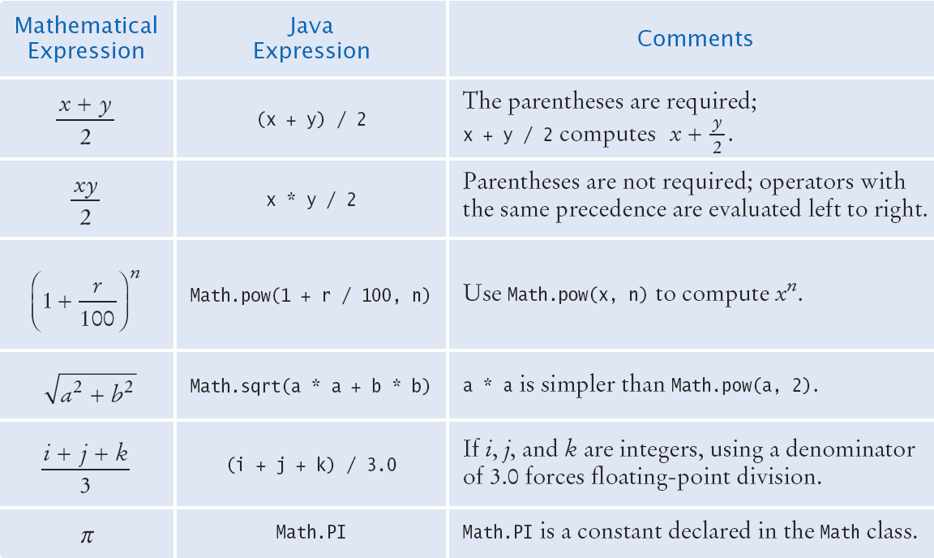
Powers and Roots (Cont'd)

Slide 41
Questions?

Slide 42
Converting and Formatting Data

Slide 43
Converting Between Data Types
It is safe to convert a value from an integer data type to a floating point data type
No decimal points (precision) is lost
Going the other way can be dangerous
All fractional information is lost
To "force" a conversion, variables can be cast from one type to another
Example
double balance = total + tax;
int dollars = (int) balance;
The fractional part is discarded (not rounded)
If you do not use the cast, the compiler will generate a syntax error

Slide 44
Formatted Output
Outputting floating point values can look strange, such as at gas stations
Example: Price per liter = 1.21997
To control the output appearance we can create and format a String containing a number through a format specifier
Once the string has been formatted, we can output it
The book covers more detailed ways you can format your output

Slide 45
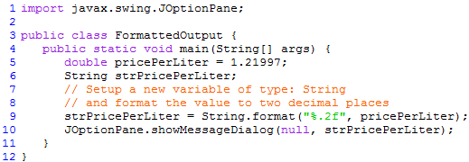
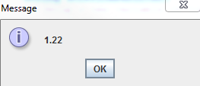
Formatted Output (Cont'd)

Slide 46
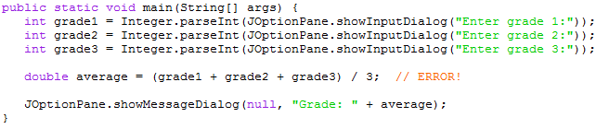
Common Errors
Unintended Integer Division
Why an error?
Since all of the data types are integers, the compiler performs integer division
Then the resulting integer is assigned to a double
When decimal points are important, use a floating-point type

Slide 47
Common Errors (Cont'd)
Unbalanced Parentheses
The count of ( and ) must match
Incorrect: -(b * b - (4 * a * c) ) ) / 2 * a)
It can be difficult to keep track
Trick:
Count ( as + 1 and ) as -1. Goal : 0
Example:
-(b * b - (4 * a * c) ) ) / 2 * a)
1 2 1 0 -1 -2

Slide 48
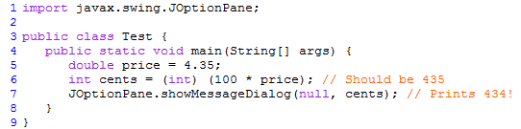
Common Errors (Cont'd)
Round Off Errors – Why?
The float value 4.35 (in binary) is not exact
Multiplying by 100 adds to the inaccuracy
When the float is converted to an int, the entire fractional part is thrown away
Be careful about using integers when you really want a floating point number, especially for calculations

Slide 49
Questions?

Slide 50
Strings

Slide 51

Strings
The String data type stores a set of characters
Once you have a string variable you can use methods on it, such as finding the length
The maximum length of a string is the size of an integer
"" is considered an empty String (length 0)

Slide 52


String Concatenation (+)
You can add or concatenate one String onto the end of another
You can also concatenate a number to a String

Slide 53

String Escape Sequences
How would you store a " within a String?
Preface the " with a \ inside the double quoted String
How would you print a backslash?
Preface the \ with another \
Special characters inside String
To create a new line, use \n

Slide 54
Questions?

